Slide 1


Comparative Study
of Collaborative Filtering Methods
for Movie Recommendation
on MovieLens Latest 2023 Dataset with 33.8M ratings
Yuting Zhou · Yiwei Li
Notes:
Today I will present the paper Locating and Editing Factual Associations in GPT. The main question behind this work is very simple but very important: when a language model answers a factual question correctly, where is that fact actually stored inside the network?
The authors do not stop at asking whether the model knows facts. Instead, they try to identify the mechanism of factual recall. Their argument is that factual associations are mediated by a specific computation inside the model, rather than being hopelessly distributed everywhere. Then they push that claim one step further. If we really understand where the fact is stored, we should be able to directly edit it.
That is why the paper has two major parts. First, it uses causal tracing to locate the internal states that matter most for factual recall. Second, it introduces ROME, a rank-one model editing method that modifies a single factual association by writing a new key-value pair into a targeted MLP module. The experimental results suggest that this view is not only interpretable, but also operationally useful.

Slide 2
Introduction
In this project, we implemented SIX distinct collaborative filtering models from scratch. All models are trained on the same MovieLens Latest split and evaluated using a unified metrics suite.
Our contributions are threefold:
Provide a controlled comparison of CF models under identical data conditions:
MF-SGD
Deep Hybrid CNN
SVD-Ridge, SVD-KNN, SVD-Lasso
MF-ALS
Analyze not only aggregate accuracy (MAE,RMSE) and ranking quality (Precision, Recall, F1, NDCG@10) but also training dynamics, latent factor semantics, and feature block ablation.
Build StreamX, an end-to-end web application (Django + Next.js) that serves real-time recommendations from the trained models, demonstrating practical deployment.
Notes:
The paper starts from a gap in prior work. Earlier studies had shown that language models can answer factual prompts, so in that sense they appear to store world knowledge. But that observation is still very shallow. It tells us that the model can produce a correct token, but not how that prediction is generated internally.
The authors emphasize that GPT-style models deserve special study because they are autoregressive. Their generation process is directional, and their architecture differs from masked language models like BERT. So it is not safe to assume that factual recall works in exactly the same way.
The motivating idea is also methodological. If knowledge is stored through some identifiable computation, then we may be able to edit it directly. That would matter for interpretability, model debugging, and post-training correction. But if facts are represented in a completely entangled and unstructured way, then precise editing should be impossible. This paper is essentially an empirical test of that question.

Slide 3
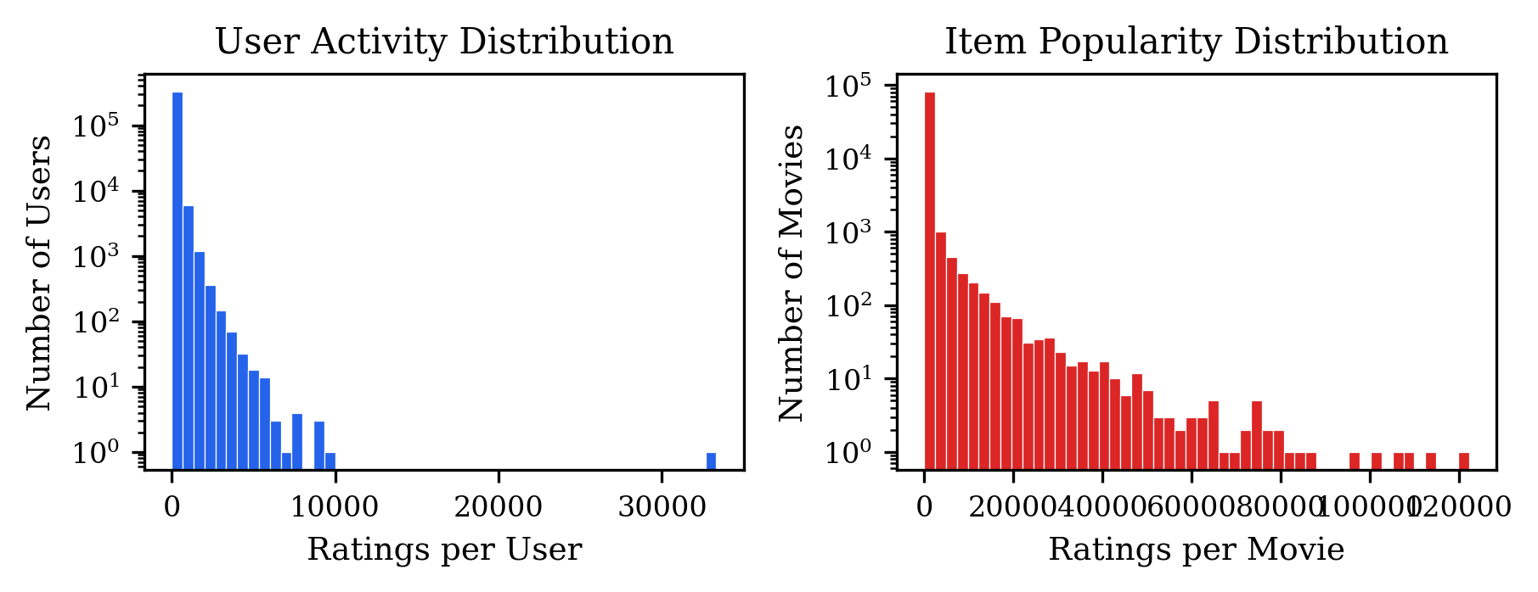
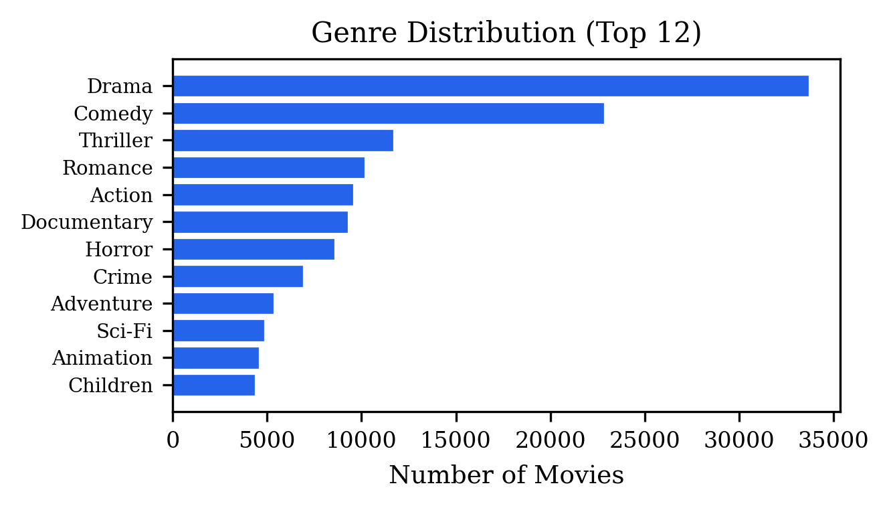
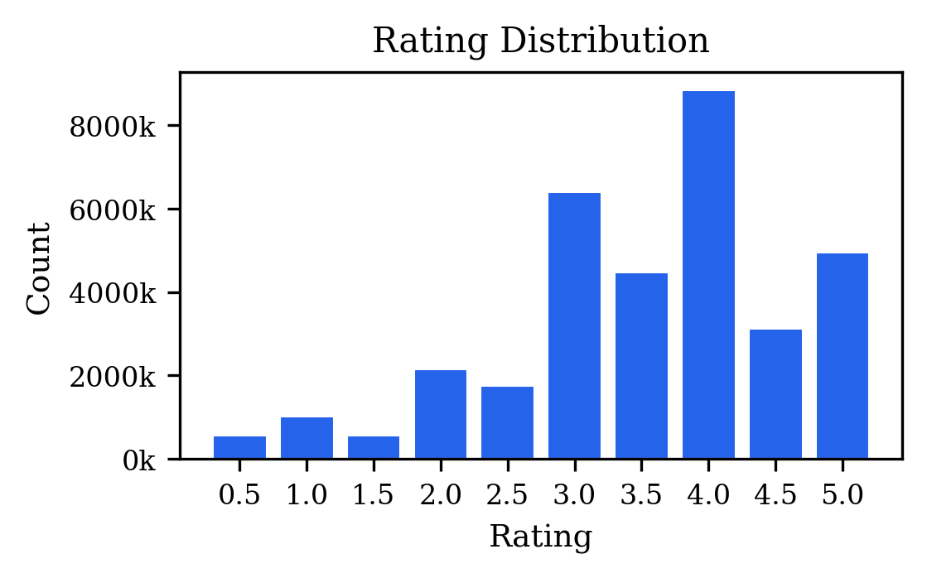
Dataset: MovieLens Latest 2023 Characteristics
Statistic | Value
Users | 330,975
Rated movies | 83,239
Ratings | 33,832,162
Density | 0.12%
Sparsity | 99.88%
Mean rating | 3.54
Median ratings/user | 31.0
Median ratings/item | 5.0
Heavy-Tailed Users (Gini ≈ 0.70)
Per-User 80/20 Split
Long-Tail Items (Gini ≈ 0.95)
Majority rate <100 items; power users exceed 10K. Regularization must account for varying observation counts across users.
Each user independently splits; ensures all models see the same user history, making comparisons directly valid.
Most movies receive <10 ratings — cold-start is endemic. Content features (title, genre) help denoise tail items.

Slide 4

Methodology: Six Collaborative Filtering Models
All models follow a common prediction form:
We evaluate them under the same protocol using a fixed-seed per-user 80/20 holdout split, resulting in Dtrain = 27.07M and Dtest ​= 6.77M ratings.
Model | Type | k | Loss | Optimizer | Epochs | Key Feature
MF-SGD | MF | 64 | MSE | Mini-batch SGD | ≤150 | LR decay 0.99×/ep; early stop
Deep Hybrid | Neural CF | 96 | Huber | Adam + plateau | 50 | CNN title + genre embed
SVD-Ridge | SVD + Linear | 48 | MSE | Ridge (closed) | 1 | Calibration: wᵀφ(u,i)
SVD-Lasso | SVD + Linear | 48 | MSE | Lasso (CD) | 1 | L1 sparsifies weights
SVD-KNN | SVD + Cosine | 48 | — | None | 1 | L2-norm item factors
MF-ALS | MF | 96 | MSE | Alternating LS | ≤40 | Block coordinate descent

Slide 5
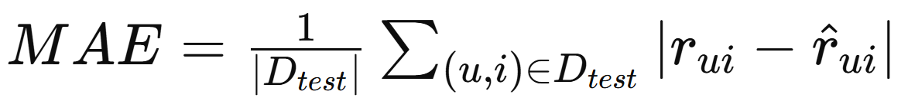
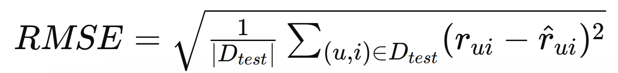
Experimental Setup
Evaluation Protocols
All models share an identical per-user 80/20 holdout split
(with fixed random seed):
D_train: 27,065,494 ratings
D_test: 6,766,668 ratings
Rating Prediction
MAE and RMSE computed over all 6.77M test ratings.
Top-10 Recommendation
For each user, all unrated items are ranked by predicted score, and the top 10 are selected. All held-out test items treated as relevant.
Metrics:
MAE
Precision@10
F1@10
RMSE
Recall@10
NDCG@10

Slide 6
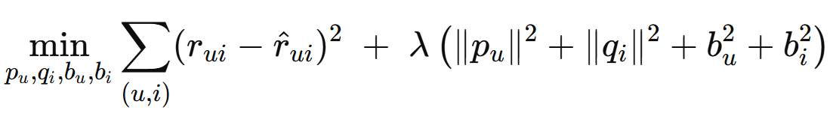

Matrix Factorization with SGD
L2-Regularized MSE Objective:
Hyperparameters
Latent dimension: k = 64
Learning rate: η = 0.005, decay 0.99× / epoch
Regularization: λ = 0.05 (L2)
Batch size: 131,072 ratings
Early stopping: patience = 6 epochs
Initialization: N(0,0.1) for all factors
User ID
p_u, b_u
Dot Product + Bias
Rating Score
Item ID
q_i, b_i
Design Motivation
Risks
Engineering Considerations
Simple structure, interpretable, and low training cost; serves as a collaborative filtering baseline to assess the achievable upper bound using pure latent ID signals.
Optimizing only squared error can lead to early overfitting after reaching the best validation error; improvements in ranking quality are not guaranteed.
Use large batch sizes to increase throughput, and apply validation checkpoint restoration to avoid post-training performance degradation.

Slide 7
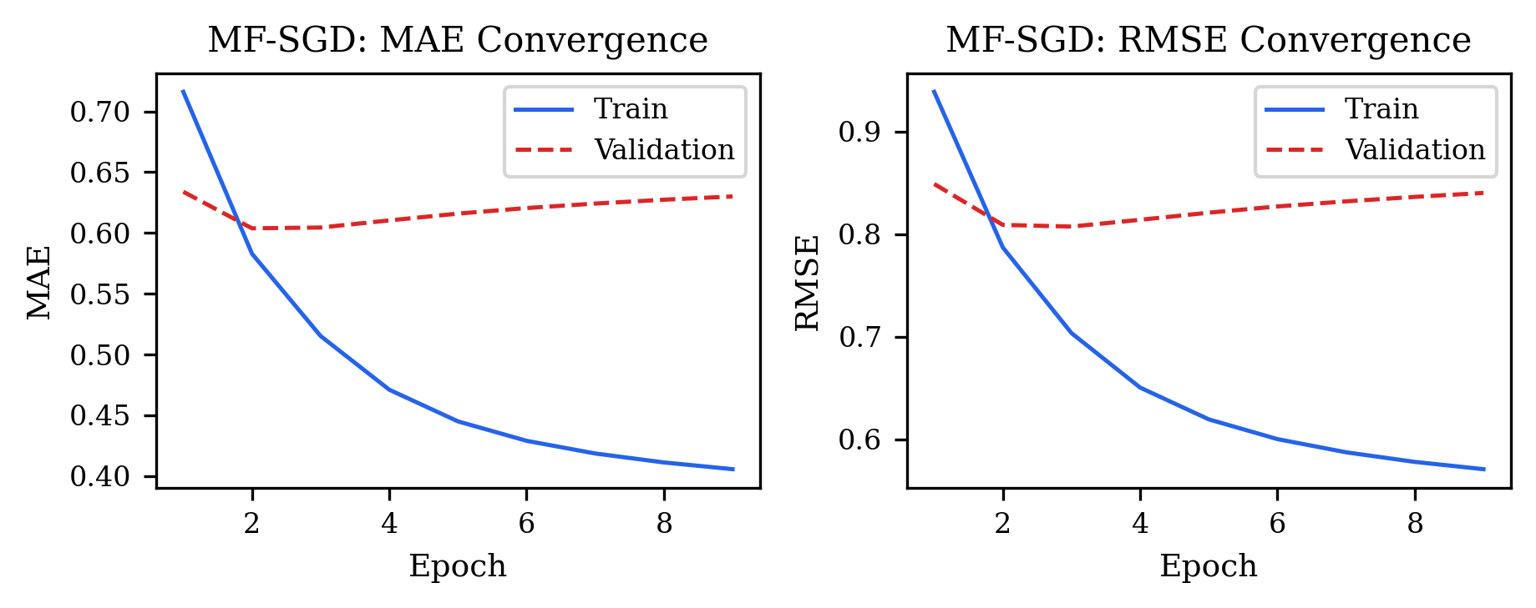
MF-SGD ANALYSIS
Strong RMSE, but Not Optimal for Ranking.
Strong Point-wise Accuracy
MF-SGD achieves the lowest RMSE among all methods, indicating that latent factors + bias terms effectively fit explicit ratings.
Weak Top-N Ranking
0.6020
MAE
2nd
0.8061
RMSE
BEST
0.0509
NDCG@10
3rd
3
Best Epoch
NDCG@10 is lower than Deep Hybrid and SVD-Ridge, suggesting that optimizing MSE does not directly separate top-10 candidates in ranking.
Takeaway
It is a strong baseline for rating prediction, but it highlights a key insight:
rating accuracy and ranking quality are related but not equivalent objectives.

Slide 8
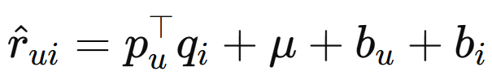
Deep Hybrid (Two-Tower + CNN)
User Tower
Item Tower
Core Idea
User ID
Item ID
Title tokens
Genre tokens
Beyond collaborative filtering ID embeddings, introduce title CNN and genre pooling so the item tower can leverage content signals, alleviating long-tail sparsity.
Embedding
ID embedding
Title CNN
Genre embedding
Training Strategy
Loss: Huber (δ = 1.0)
Optimizer: Adam, LR 8×10⁻⁴
LR schedule: ReduceLROnPlateau (×0.5, patience 4)
Gradient clip: L2 norm ≤ 1.0
k = 96, dropout 0.18, L2 λ = 10⁻⁵
Batch: 65,536 (GPU); rating-weighted sampling
Dropout
Concat
p_u
MLP (192 → 96)
CNN Title Encoder
Genre: embed (d=8) → AvgPool → ℝ⁸.
Concatenated with ID embed → MLP → q_i
q_i
Dot Product + Bias (μ, b_u, b_i)
Prediciton

Slide 9
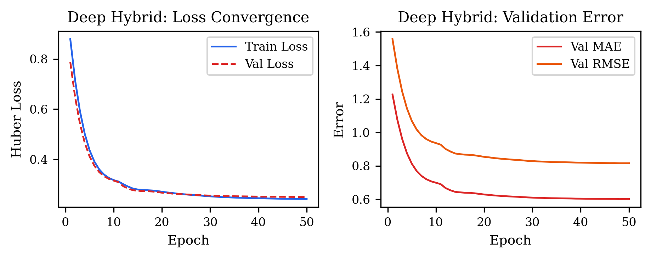
Deep Hybrid ANALYSIS
Why It Achieves the Best Overall Performance?
Mechanism Explanation
ID embeddings capture collaborative filtering signals, while the title CNN and genre pooling model longer-range item semantics, providing complementary content features. The Huber loss further stabilizes rating prediction.
Source of Ranking Gains
0.6005
MAE
BEST
0.0533
P@10
BEST
0.0480
R@10
BEST
0.0722
NDCG@10
BEST
Rating-weighted sampling and content features make high-scoring items more distinguishable in ranking, leading to a clear improvement in NDCG@10.
Trade-off
Takeaway
The model is structurally more complex and relies more on GPU training and feature processing. However, at this data scale, the additional capacity translates into real performance gains.
If the goal is overall recommendation quality, Deep Hybrid is the primary model. For cost-sensitive deployment, it should be weighed against SVD (Ridge).

Slide 10
SVD Representation + Three Heads
Shared Backbone
Construct a centered interaction matrix, apply truncated SVD to obtain user/item latent factors, then estimate bias shrinkage.
Rating matrix
Truncated SVD
k = 48
Bias shrinkage
lambda_b
Feature phi(u,i)
p_u * q_i + biases
Ridge
(L2 calibration, α = 0.1)
Strong linear head with stable ranking performance
Lasso
(L1 calibration, max_iter = 2000)
Sparse solution, but weaker ranking performance
KNN-style
(mean-normalized item vectors, cosine-like score)
Highly interpretable, but lacks proper calibration
Design Positioning
SVD captures collaborative structure, while the head determines scoring calibration or geometric interpretation.

Slide 11
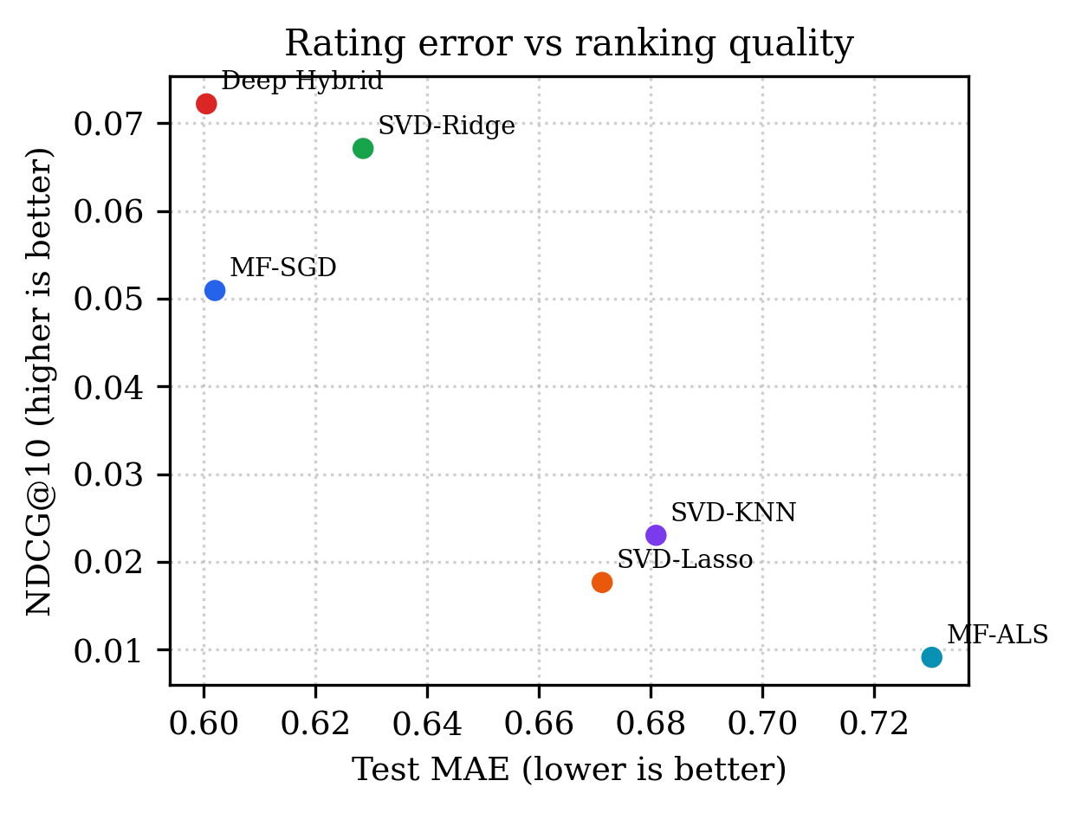
SVD ANALYSIS
Ridge Approaches Deep, Lasso/KNN Expose Head Differences
Head | MAE | RMSE | P@10 | NDCG | Interpretation
Ridge | 0.6286 | 0.8312 | 0.0520 | 0.0671 | Strong
Lasso | 0.6714 | 0.8747 | 0.0152 | 0.0177 | Too sparse
KNN | 0.6810 | 0.9058 | 0.0159 | 0.0230 | Uncalibrated
Why Ridge Works?
Why Lasso Underperforms?
Why KNN is Meaningful?
L2 calibration re-adjusts the SVD latent product and bias terms, suppressing SVD noise while preserving sufficient score diversity.
L1 sparsity reduces calibration weight diversity, leading to acceptable rating error but significantly degraded top-N ranking.
User vectors represent the centroid of rated item factors, essentially a latent-space average. It is highly interpretable, but lacks regression-based calibration.

Slide 12

Alternating Least Squares
Using Ridge Regression while keeping user embeddings fixed:
Hyperparameters
k=96, reg =0.16, bias_reg =6.0, epochs =40, validation split =10%, early stopping patience = 6
Fix Q
Solve all user P, b_u
Fix P
Solve all item
Q, b_i
Core Idea
Theoretical Advantages
Challenges
Fix item factors Q, solve a regularized least-squares problem for each user; then fix user factors P and solve the symmetric problem for each item, alternating until convergence.
Each block update is a closed-form least-squares solution; well-suited for sparse matrices and a strong scalable baseline in classical collaborative filtering.
Ranking performance is sensitive to the interaction of rank, regularization, and bias shrinkage under a long-tail sparse structure; current preset does not achieve strong ranking quality.
Note: This does not reject ALS; it indicates that, under explicit-feedback settings, a more systematic sweep over rank and regularization is still needed.

Slide 13
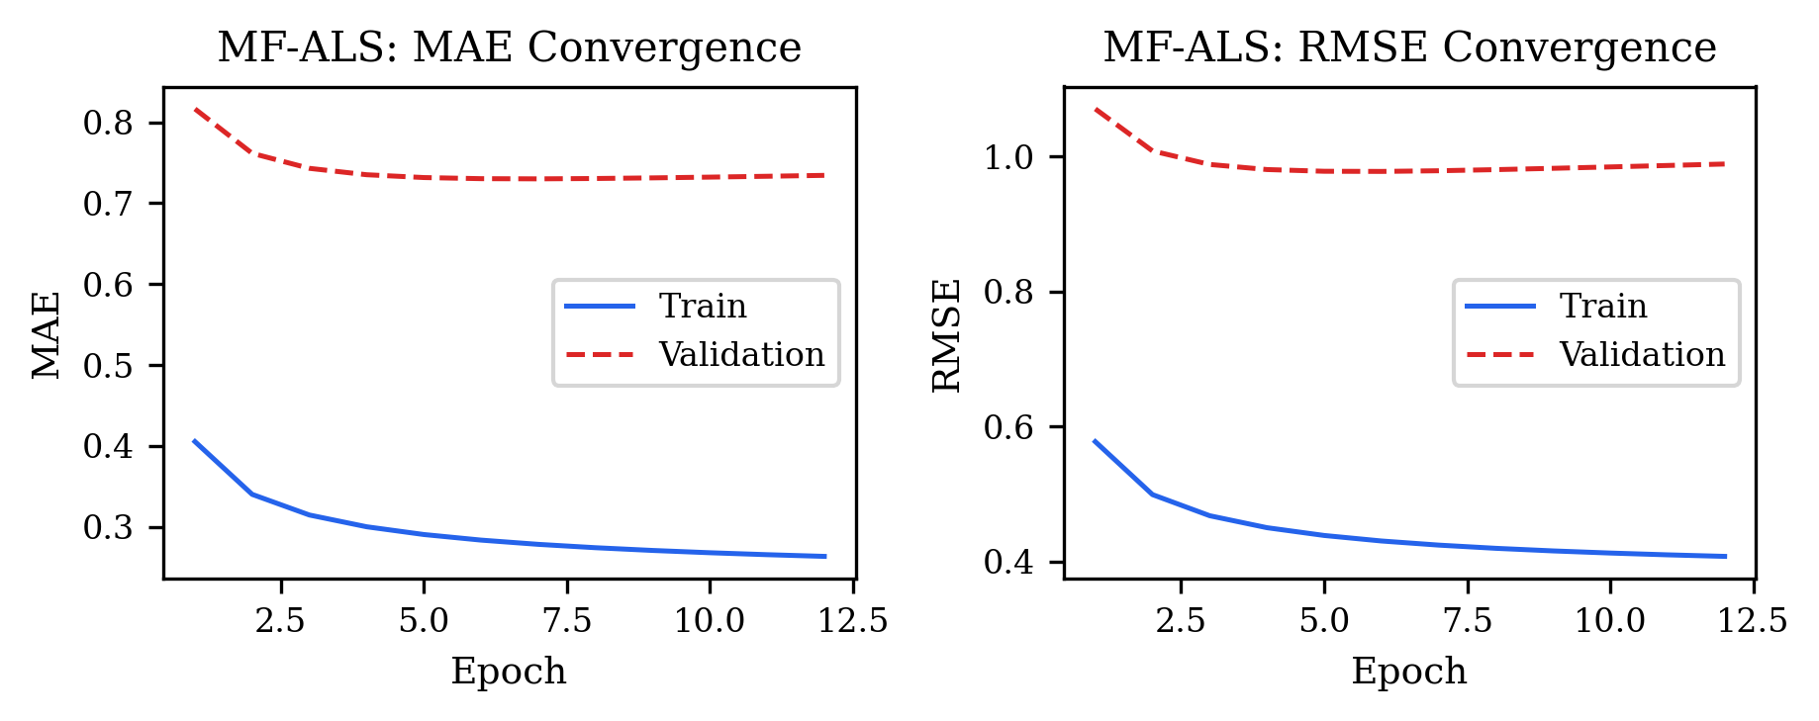
MF-ALS ANALYSIS
Training Objective Improves,
but Validation and Ranking Lag Behind.
Overfitting / Mismatch
The training objective continues to decrease, but validation error plateaus early, indicating a mismatch between current regularization/ranking setup and the large-scale data split.
0.7303
MAE
WORST
0.9786
P@10
WORST
0.0072
NDCG@10
WORST
0.0091
NDCG@10
WORST
Weak Score Separation
Top-10 metrics are the lowest among all models, suggesting that predicted scores fail to effectively distinguish relevant from irrelevant items.
Takeaway
Next Steps
ALS is a meaningful but under-optimized classical baseline.
Its limitations highlight that evaluation cannot rely solely on training loss.
Rank-aware hyperparameter sweep
Per-block regularization
Implicit-feedback ALS or confidence-weighted formulation

Slide 14
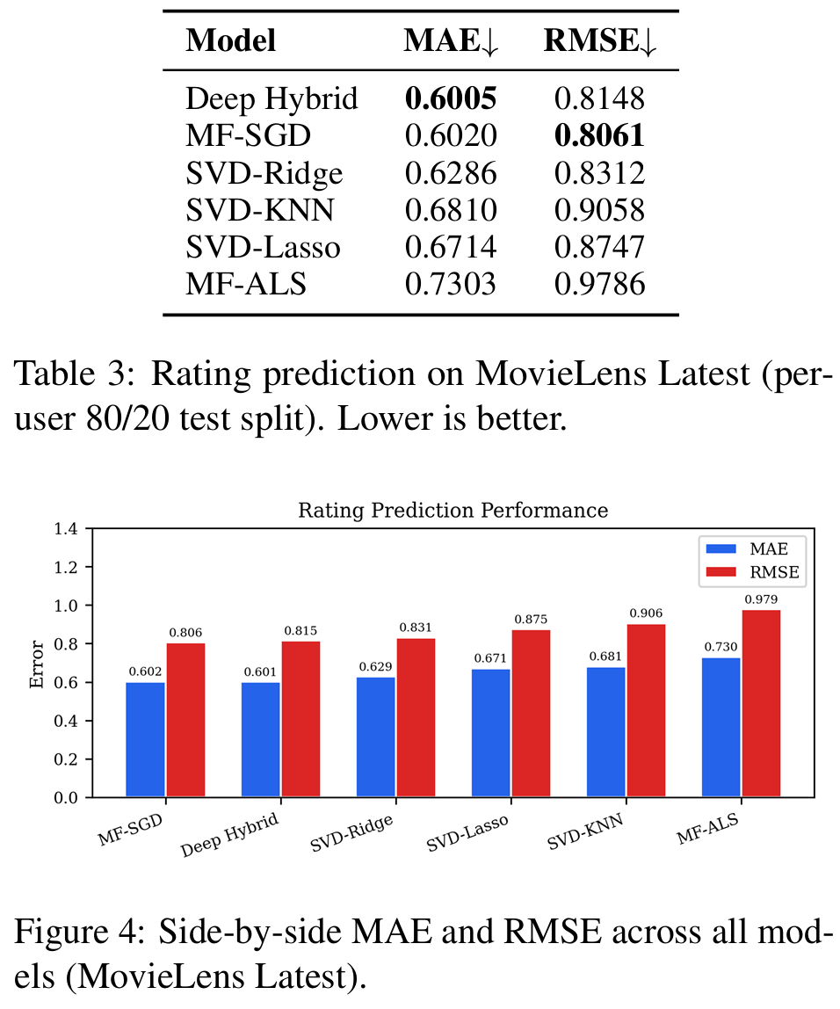
Results: Rating Prediction
Rating Prediction Performance Test
(Lower MAE and RMSE indicate better accuracy)
Key Findings (MovieLens Latest, 80/20 split)
Deep Hybrid achieves most stable average prediction accuracy
MF-SGD obtains the best RMSE, better control on large errors
SVD-based methods show consistent performance gap → limited expressiveness
MF-ALS performs worst → potential optimization or scalability issues
Takeaway
Nonlinear modeling (Deep Hybrid) and well-optimized MF (SGD) significantly outperform classical CF variants.
Traditional SVD-style extensions struggle at large scale and high sparsity.

Slide 15
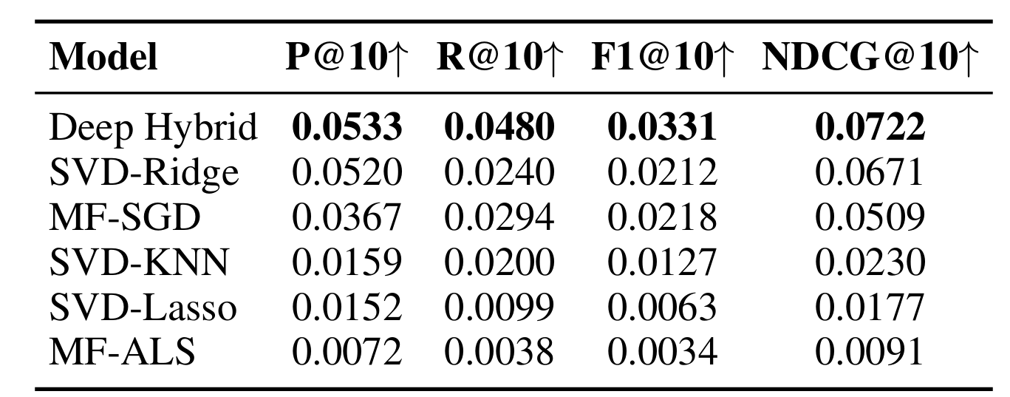
Results: Top-10 Recommendation
Top-10 Ranking Metrics (Higher is Better)
Holdout-style evaluation: all held-out test items per user treated as relevant.
Interpretation
Model ranking ability ≠ rating accuracy: MF-SGD is strong in RMSE but weaker in top-K ranking
Nonlinear hybrid modeling (Deep Hybrid) better captures relative preference signals
Absolute metric values are low due to all test items treated as relevant, so relative ordering is the key signal
Takeaway
For recommendation tasks, optimizing ranking objectives is more aligned with UX than pure rating prediction
Deep Hybrid provides the best balance between representation power and ranking effectiveness
Absolute values are small because each user has many held-out test items (all_test relevance definition). Relative ordering across models is the meaningful signal.

Slide 16
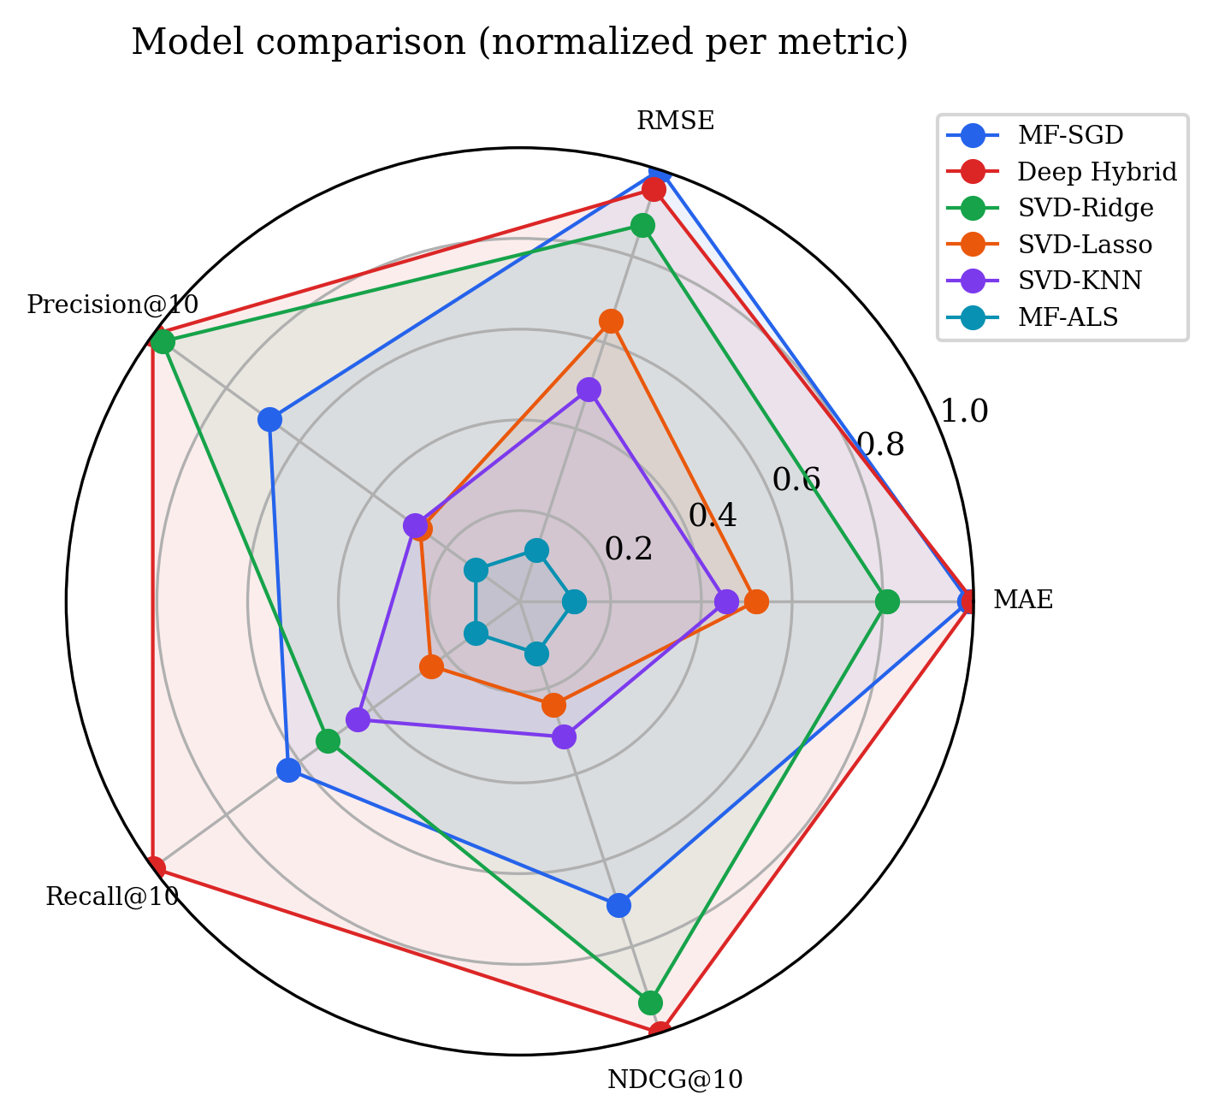
Multi-Metric Diagnosis
Model Roles Matter More Than a Single Ranking.
Primary Model
Lightweight Baseline
Needs Improvement
Deep Hybrid achieves the best overall performance, making it suitable for scenarios that demand high recommendation quality.
SVD-Ridge delivers ranking performance close to Deep Hybrid, with significantly lower training and interpretation cost.
ALS, Lasso, and KNN share common limitations in score calibration and ranking separation.

Slide 17


Training Dynamics
MF-SGD
Deep Hybrid
MF-ALS
Behavior
Behavior
Behavior
Rapid initial progress on training objective. Validation MAE/RMSE reverse direction within first few epochs.
Smooth convergence under Huber loss with GPU minibatches (batch=65,536). Validation metrics improve steadily.
Training error decreases monotonically. Validation error plateaus then drifts — train/val divergence.
Best Checkpoint
Best Checkpoint
Best Checkpoint
Typically epoch 2–4 despite training up to 150 epochs. Early stopping (patience 6) is essential.
Epoch 48 of 50-epoch run. ReduceLROnPlateau triggers LR reductions, stabilizing training.
Early stopping triggers at epoch 12; restores epoch-6 checkpoint (k=96, λ=0.16).
Train error ↓ continuously; val error ↑ after epoch 4 → checkpoint restoration critical.
Content features (title CNN + genre) help denoise tail items, improving both RMSE and NDCG.
Current preset is a baseline, not a fundamental limit. Large-scale MF-ALS requires rank/reg sweep, preconditioning, and possibly implicit-feedback formulation.

Slide 18
Feature-Block Ablation & Latent Factor Analysis
Feature-Block Ablation (MovieLens-Small-1M, Linear Probe)
Latent Factor Interpretation (MF-SGD)
Auxiliary study to understand which feature blocks contribute most to rating prediction beyond collaborative filtering.
PCA on Item Factors
PCA applied to item factor matrix Q (k=64, |I|≈83K rated items). Principal components correlate with genre indicators and release year.
Feature Block | R²_full | R²_w/o | ΔR²
Full model | 0.1116 | — | —
w/o Content | — | 0.0582 | 0.0534
w/o Engagement | — | 0.0815 | 0.0302
w/o Noise (control) | — | 0.1117 | -0.0001
Semantic Axes
On smaller MovieLens slices, PCA yields coherent axes: e.g., mainstream blockbusters vs. critically acclaimed dramas from collaborative signal alone.
Full-Scale Caveats
Feature blocks: (1) Content: genre indicators, genre count, release year, interaction year. (2) Engagement: log user activity, log item popularity, log tag count. (3) Noise: two random Gaussian features (control).
At full scale, individual movie exemplars become noisier across training seeds. Interpretable directions are emphasized over selectively chosen examples.
Content features account for the largest marginal contribution (ΔR²=0.053), motivating the Deep Hybrid's title CNN and genre encoder. Most variance remains latent-ID-driven.

Slide 19
Deployment: Full Stack Web Demo Architecture
StreamX
This demo translates offline experimental metrics into observable product behavior:
users can switch models and directly compare recommendation lists and similar-movie results.
Next.js 16
Browse, details, recommendation lists
Django REST API
Unified service interface and model switching
Model Artifacts
Deep / MF / SVD / ALS checkpoints
TMDB Enrichment
Posters, metadata, similar movies
Step | Input | API Action | Model Output | UI Result
1 | User profile | Candidate scoring | Ranked movie IDs | Recommendations
2 | Movie ID | Similarity lookup | Neighbor titles | Similar movies
3 | Metadata | TMDB join | Poster + details | Detail page

Slide 20
Discussion & Conclusion
Limitations
Uses a development dataset; metrics tied to July 2023 snapshot
No automated hyperparameter search for MF-ALS and SVD-KNN
Top-N evaluation on all_test leads to low absolute Precision/NDCG
No modeling of temporal dynamics or implicit feedback
Future Work
Learning-to-rank optimization (e.g., BPR, NDCG-aligned objectives)
Large-scale rank and regularization sweep for MF-ALS
Rating-weighted KNN profile enhancement
StreamX Web Demo
Built with Django + Next.js
Supports real-time recommendations
Integrated with TMDB metadata
Enables runtime model switching
Link: StreamX: Movies Recommender

Slide 21
Thank you
Comparative Study of Collaborative Filtering Methods
for Movie Recommendation
Yuting Zhou · Yiwei Li

